Slide 1
Pennsylvania’s
Prescription Drug Monitoring Program (PA PDMP)
ABC-MAP Act 191 of 2014
September 16, 2016

Slide 2
Agenda
Scope of the issue
Leadership is the key
PA PDMP Champions Program Purpose of Act 191
Prescriber requirements of Act 191
How to register Use of delegates
Data elements available
Future program enhancements
Q&A

Slide 3
Scope of the issue

Slide 4
Leadership is the key
As Pennsylvania’s federally qualified health center leaders, will you take a leadership role in educating local medical staff about the PDMP and registering them for the system?

Slide 5
PA PDMP champions
Types of Champions:
Medical Leadership Champions Clinical Practice Champions
Recruiting Champions from:
Professional Societies
Hospital and Health System leaders (Urban/Rural) Academic Medical Centers
Prescribers and Dispensers in PA
County & Municipal Health Departments

Slide 6
Purpose of Act 191
Q: What is the purpose of the new PDMP?
A: The purpose of the PDMP established by ABC-MAP Act 191 of 2014 is:
To be used as a tool to increase the quality of patient care by giving prescribers and dispensers access to a patient's controlled substance prescription medication history, which will alert medical professionals to potential dangers for purposes of making treatment determinations; and
To aid regulatory and law enforcement agencies in the detection and prevention of fraud, drug abuse and the criminal diversion of controlled substances.

Slide 7
Prescriber requirements of Act 191
Q: What are the requirements for prescribers regarding
the use of the PA PDMP?
A: According to Act 191, prescribers shall query the system:
For each patient the first time the patient is prescribed a controlled substance by the prescriber for purposes of establishing a baseline and a thorough medical record; or
If a prescriber believes or has reason to believe, using sound clinical judgment, that a patient may be abusing or diverting drugs.

Slide 8
HOW DO YOU REGISTER?

Slide 9
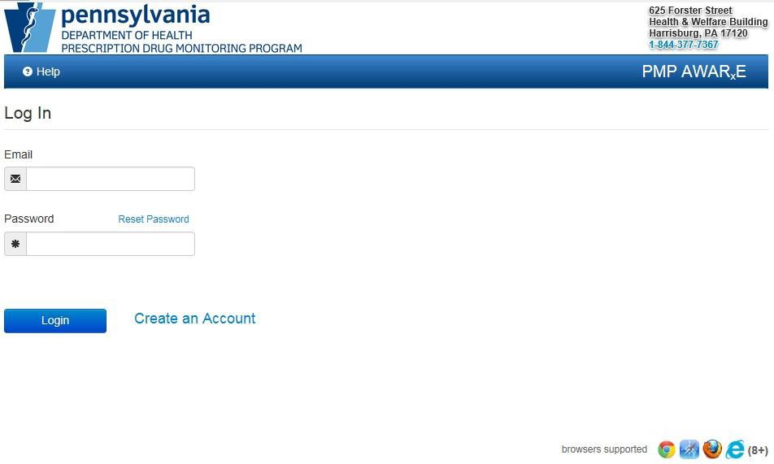
Register for a New Account
This tutorial provides you a "step by step" process of registering for a new account in PA PMP AWARxE. Once you create an account and it's validated, an approval email will be sent to you.
This tutorial covers how to:
Create an account;
Select your role; and
Complete the registration process.

Slide 10
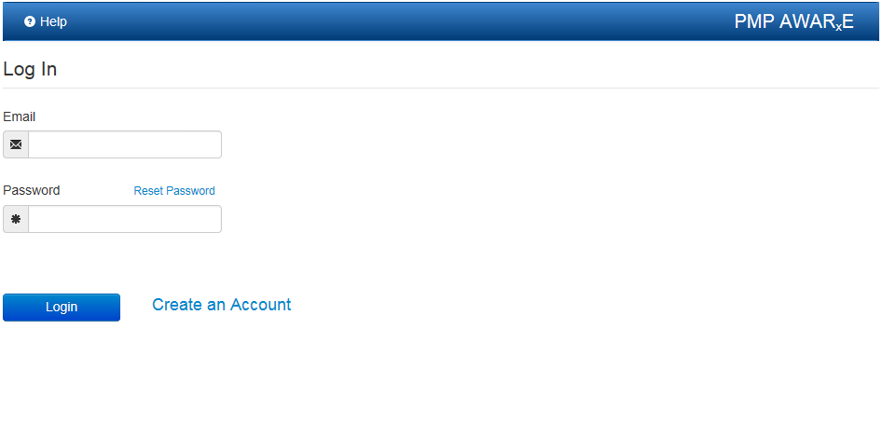
Step 1
Create an Account
To begin the process, click on "Create an Account."

Slide 11
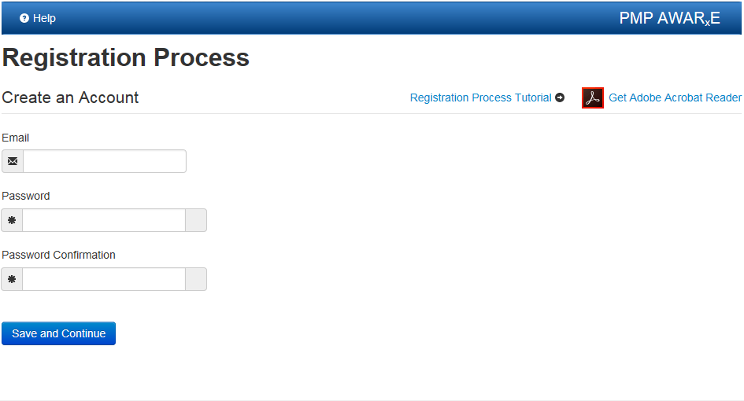
Step 2
Create an Account
Note: Your email is your username. Passwords must:
Be at least eight characters; and
Include one uppercase letter, one symbol (!, @, #, $, etc.) and one
lowercase letter.
* Please make sure to keep your passwords private and safe. Do not share them. Any intentional and/or unintentional and negligent release of information from the PDMP system is subject to civil penalties of not less than $2,500 for each offense.

Slide 12
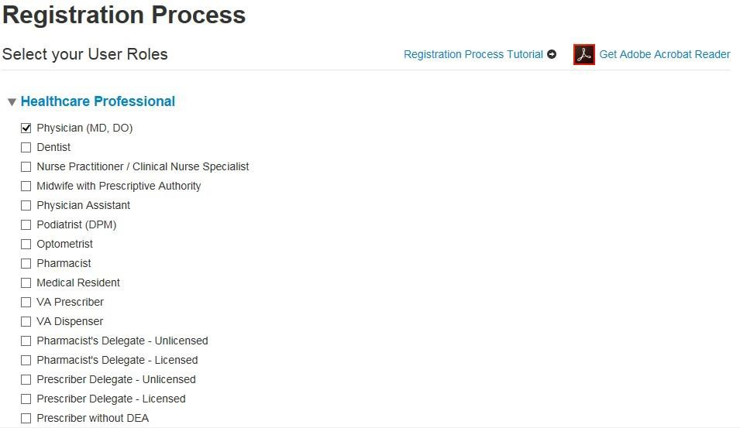
Step 3
Select your Role
Select the primary category of your role to expand the list. This will allow you to select your specific role. Click on "Save and Continue" to proceed with the registration process.

Slide 13
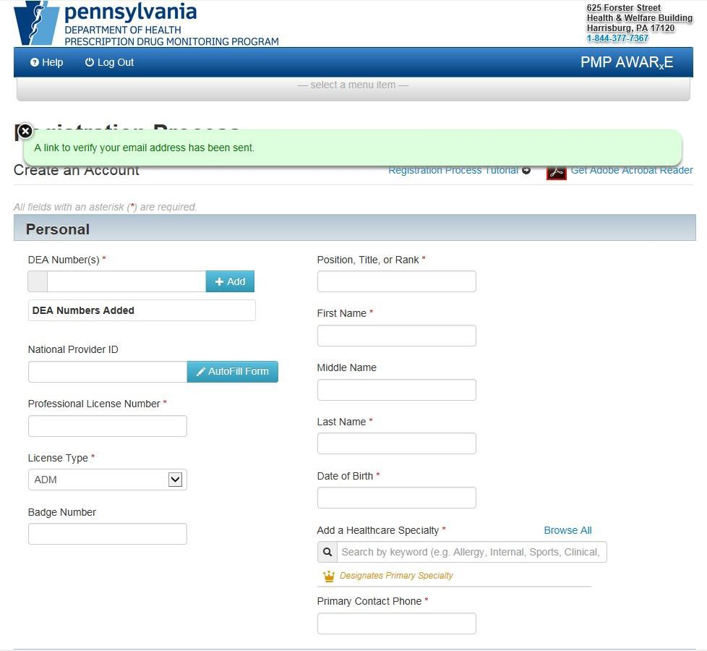
Step 4
A verification link will be
sent to the email address you entered. You will need to click on the link in the email to verify your email address so that your account approval process can begin.

Slide 14
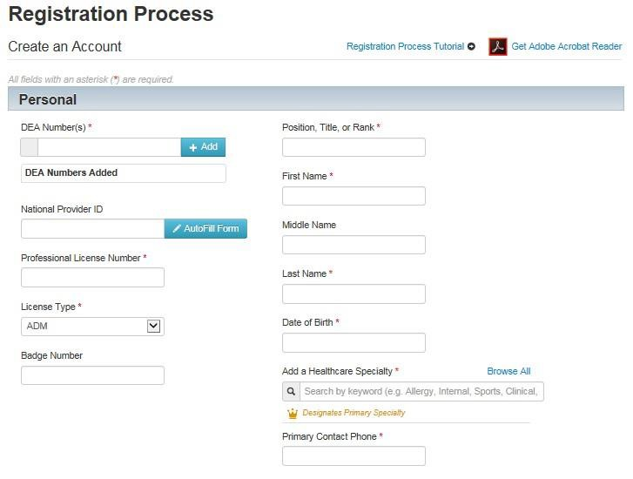
Step 5
Multiple DEA numbers can be
entered, if necessary.
Save time with the
AutoFill feature.
Scroll down to continue to employer section.

Slide 15
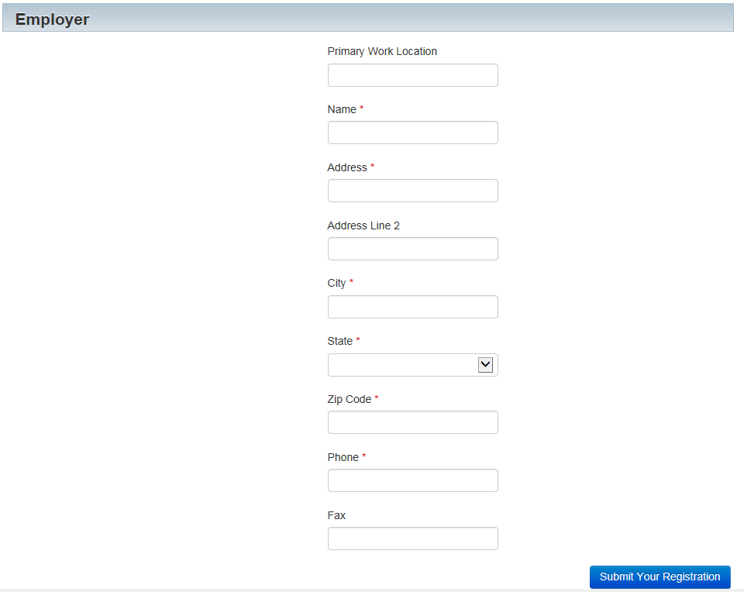
Step 6
Complete Registration Process
Complete the employer section making sure to enter information into all required fields.
AutoFill will automatically fill in
information from the NPI ID number you have provided. If AutoFill does not pre- populate it, please enter the correct information.
Please validate that all information entered into the required fields is correct.
All fields marked with an asterisk are required.
Once all information is
entered, please click on "Submit Your Registration".

Slide 16
Use of delegates
Prescriber and Pharmacist Delegate Assignment Policy
Prescribers and pharmacists are authorized to grant PA PDMP access to delegates under their employment or supervision for the purpose of querying the system on their behalf.
Delegates are not required by law to be licensed healthcare professionals.
Prescribers and pharmacists are responsible for ensuring the security
of the PDMP system when used by a delegate. This includes ensuring
that the delegates are using the PDMP appropriately, according to the acceptable use policy, and ensuring that delegate access is removed when an individual is no longer employed or supervised by them.
PA PMP AWARxE Access link
https://pennsylvania.pmpaware.net/login

Slide 17
Data elements available
All of the following information is provided by a dispensing prescriber
or a pharmacy:
The full name of the prescriber.
The prescriber's Drug Enforcement Agency (DEA) registration number.
The date the prescription was written.
The date the prescription was dispensed.
The full name, date of birth, gender and address of the person for
whom the prescription was written and dispensed.
The National Drug Code.
The quantity and days' supply.
The DEA registration number and National Provider Identifier of the dispenser or pharmacy.
The method of payment for the prescription.

Slide 18
Future program enhancements
Educate how to incorporate the PA PDMP into clinical workflows and how to connect patients to treatment
Integrate the PA PDMP system with EHR and pharmacy systems
Evaluate research capabilities and possibilities
Enhance connections to treatment and partnership between practices and single county authorities

Slide 19
Questions?
QUESTIONS?
Technical & log-in assistance 855-572-4767 (855-5PA-4PMP)
24 hours a day/7 days a week/365 days in a year
Policy assistance
844-377-7367 (844-377-PDMP)
Mon to Fri – 9 a.m. to 5 p.m. Email: RA-DH-PDMP@pa.gov Website: www.doh.pa.gov/PDMP

